Slide 1

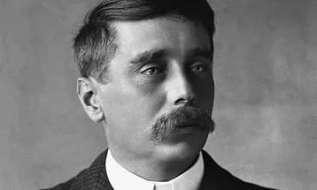
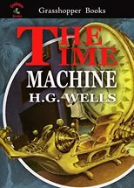




Slide 2
The theme of the lesson is
The Time machine

Slide 3
The new words
principles: scientific laws to explain how sth
works
travel-worn: slightly damaged from travel
ivory: material elephant tusks are made of
bars: long straight pieces of metal or other
material
brass: a type of metal, yellow in colour;
rail: a thin piece of metal
tap: to hit slightly

Slide 4
screws: pieces of metal which are used to
fasten pieces of material (e.g. wood) together
drop: a small amount of liquid
quartz: a hard, shiny mineral like rock
rod: a thin piece of metal, usually in the
shape of a cylinder
saddle: a seat made out of leather, usually
put on a horse’s back or the seat of a bicycle/
motorcycle
starting lever: a handle used to start sth
thud: a dull sound
whirling: moving or turning around quickly
headlong: moving along head first

Slide 5
hopping: jumping a short distance
swiftly: quickly
leaping: jumping a long distance
scaffolding: the metal structure that surrounds
a building while it is being constructed
conscious: being aware of
spinning: like whirling, moving around very
quickly
faint: weak (not bright)
glimpse: a quick sight of something
luminous: glowing or shining in the dark
twilight: the time of day between evening and
night
streak: a long line of something
arch: a curved line, usually in buildings
changing: differing in appearance
flickering: shining irregularly

Slide 6
H.G.Wells
What was H.G. Wells?
What might the book be about?
Is it fiction or non-fiction?
What books did H.G. Wells write?

Slide 7

Read and answer
What do you think the extract is about?
Who is speaking?
Listen the text

Slide 8
Read and answer
What problems did the narrator have with the time machine?
How did he fix them?

Slide 9
key
One of the ivory bars was cracked and a brass rail was bent.
He didn’t fix these. One of the nickel bars was too short and he had it remade.

Slide 10
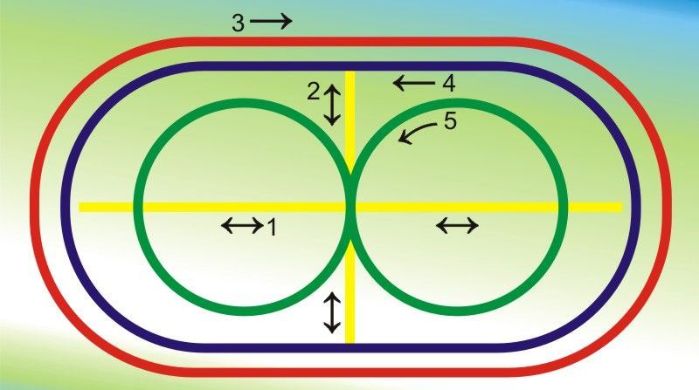
Dynamic pause

Slide 11
Key
1 D
2 C
3 E
4 B
5 A

Slide 12
Key
1 merged: Last year, our town’s two football
teams merged to become one team.
2 dashed: I didn’t want to miss that film so
I dashed home as fast as I could.
3 dim: It was late and I couldn’t read the
house numbers as it was too dim.
4 hazy: We couldn’t see the mountains at
all. It was too hazy.
5 convey: The scientist tried to convey the
is imminent.

Slide 13
6 drew: I waited and drew a deep breath.
7 sound: My grandmother’s car is over forty
years old but is still sound.
8 anticipation: Tom has no anticipation of
winning the running competition.
9 murmur: The teacher was very annoyed
with the murmur coming from the back of
the classroom.
10 imminent: Scientists say a major disaster
is imminent.

Slide 14
Key
… and I saw the sun hopping swiftly
across the sky.
с … the night came like the turning out of
a lamp
с There is a feeling exactly like that one
has upon a switchback
с As I increased speed, night followed day
like the flapping of a black wing.

Slide 15
Home task
The first group: ex.8 p.147 – give a summary of the extract
The second group: ex.9 p.147 – write a short description of your journey
The third group: ex.1,2,3,4,5,6. p.64 W.B

Slide 16
Источники:
https://yandex.ru/images/search?text=книги%20и%20фото%20велса
http://zrenieostro.com/blog/other-methods/profilaktika-zritelnogo-utomleniya-i-narushenij-zreniya-po-metodike-bazarnogo.html
Spotlight 10: Teacher's Book

